Slide 1
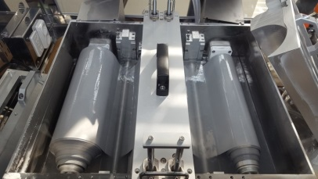
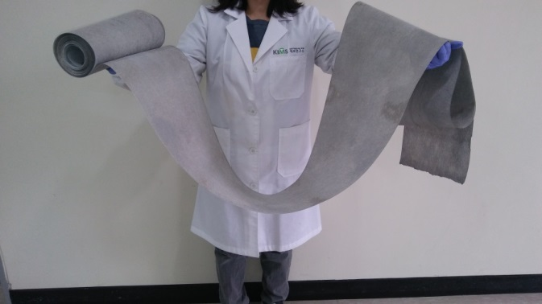
Production system for aluminum coated conductive filter
(Capacity: 18m²/batch)
Produced aluminum coated conductive filter

