Slide 1
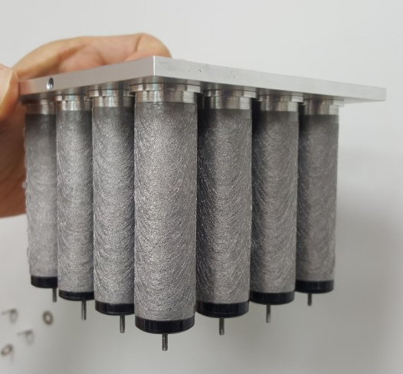
Aluminum coated conductive filter module
(filter area: 0.05 m², clean area: 8.25 m², fine particulate removal efficiency: higher than 99% at 10cm/sec)

